Slide 1
EQ2401 Adaptive Signal Processing Project 1
Ziyue Yang Boyue Jiang
ziyuey@kth.se boyue@kth.se

Slide 2
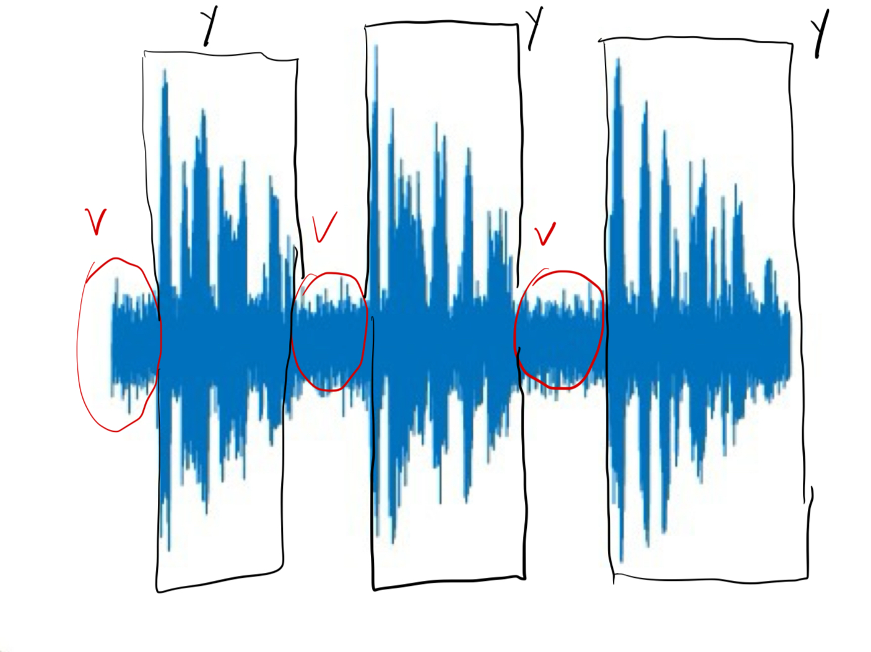
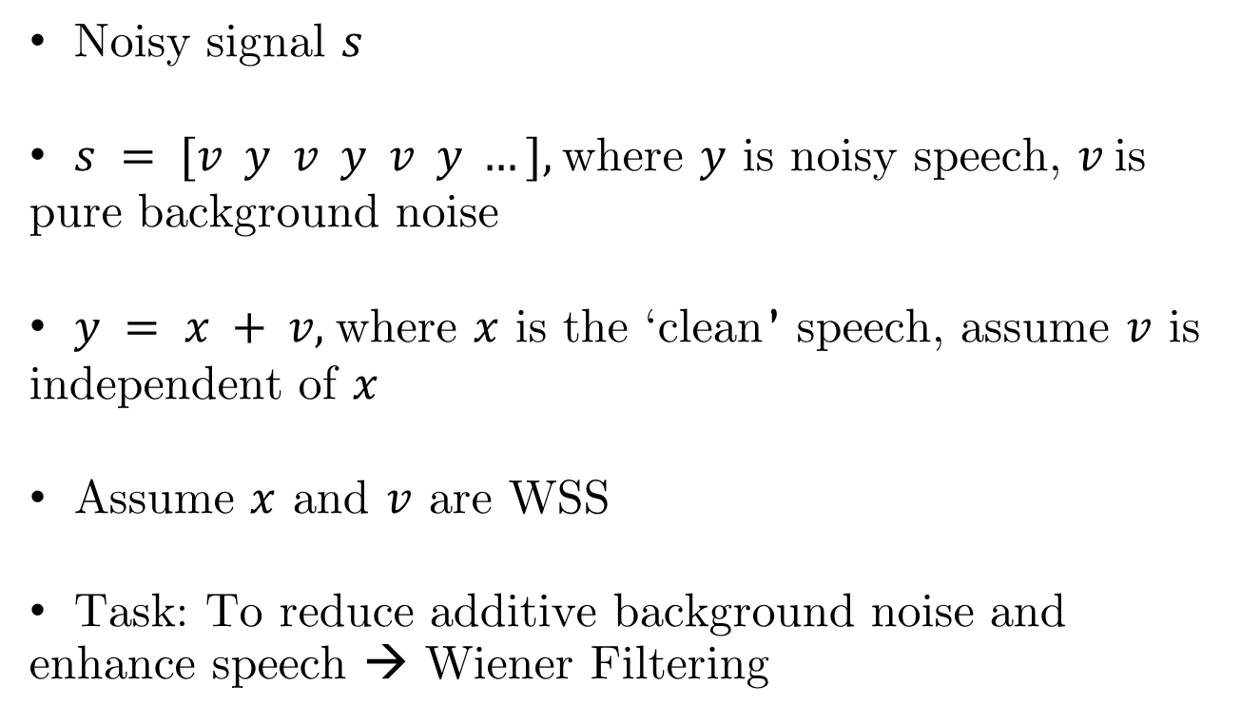
Project Description
Noisy signal $s$
$s = [v y v y v y …],$where $y$ is noisy speech, $v$is pure background noise
$y = x + v,$where $x$ is the ‘clean’ speech, assume $v$ is independent of $x$
Assume $x$ and $v$ are WSS
Task: To reduce additive background noise and enhance speech → Wiener Filtering

Slide 3
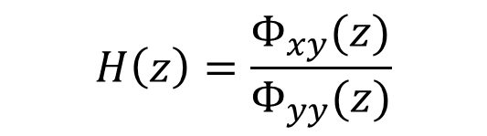
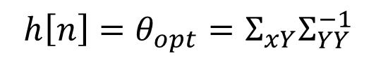
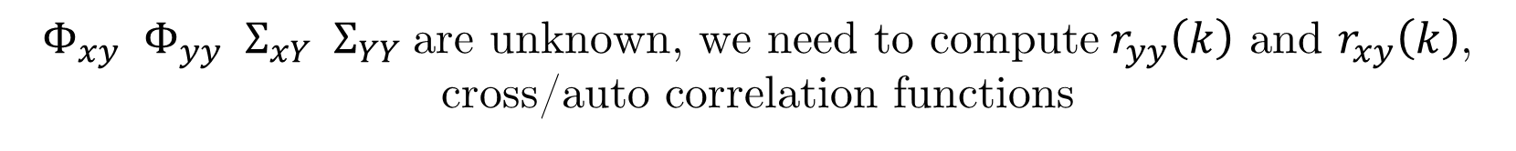

Wiener Filters
FIR
$$h\left[n\right]=θ_{opt}=Σ_{xY}Σ_{YY}^{−1}$$
$$H\left(z\right)=\frac{Φ_{xy}(z)}{Φ_{yy}(z)}$$
Non-Causal
$$H\left(z\right)=\frac{1}{{Φ^{+}}_{yy}(z)}{\left\{\frac{Φ_{xy}(z)}{{Φ^{−}}_{yy}(z)}\right\}}_{+}$$
Causal
$Φ_{xy}$ $Φ_{yy}$ $Σ_{xY}$ ${ Σ}_{YY}$ are unknown, we need to compute $r_{yy}\left(k\right)$ and $r_{xy}\left(k\right)$, cross/auto correlation functions

Slide 4
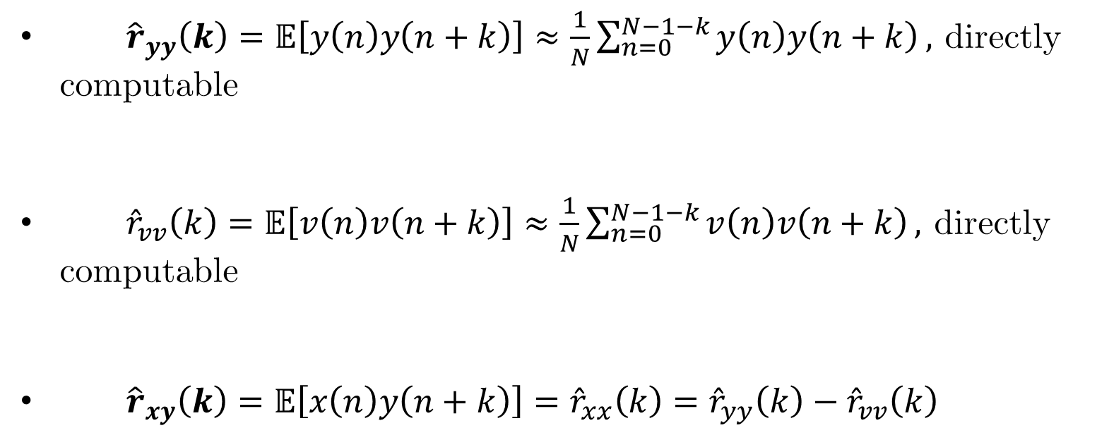
Compute Correlations
${\hat{r}}_{yy}\left(k\right)=𝔼\left[y\left(n\right)y\left(n+k\right)\right]≈\frac{1}{N}\sum_{n=0}^{N−1−k}{y\left(n\right)y\left(n+k\right)},$ directly computable
${\hat{r}}_{vv}\left(k\right)=𝔼\left[v\left(n\right)v\left(n+k\right)\right]≈\frac{1}{N}\sum_{n=0}^{N−1−k}{v\left(n\right)v\left(n+k\right)},$ directly computable
${\hat{r}}_{xy}\left(k\right)=𝔼\left[x\left(n\right)y\left(n+k\right)\right]={\hat{r}}_{xx}\left(k\right)={\hat{r}}_{yy}\left(k\right)−{\hat{r}}_{vv}\left(k\right)$

Slide 5
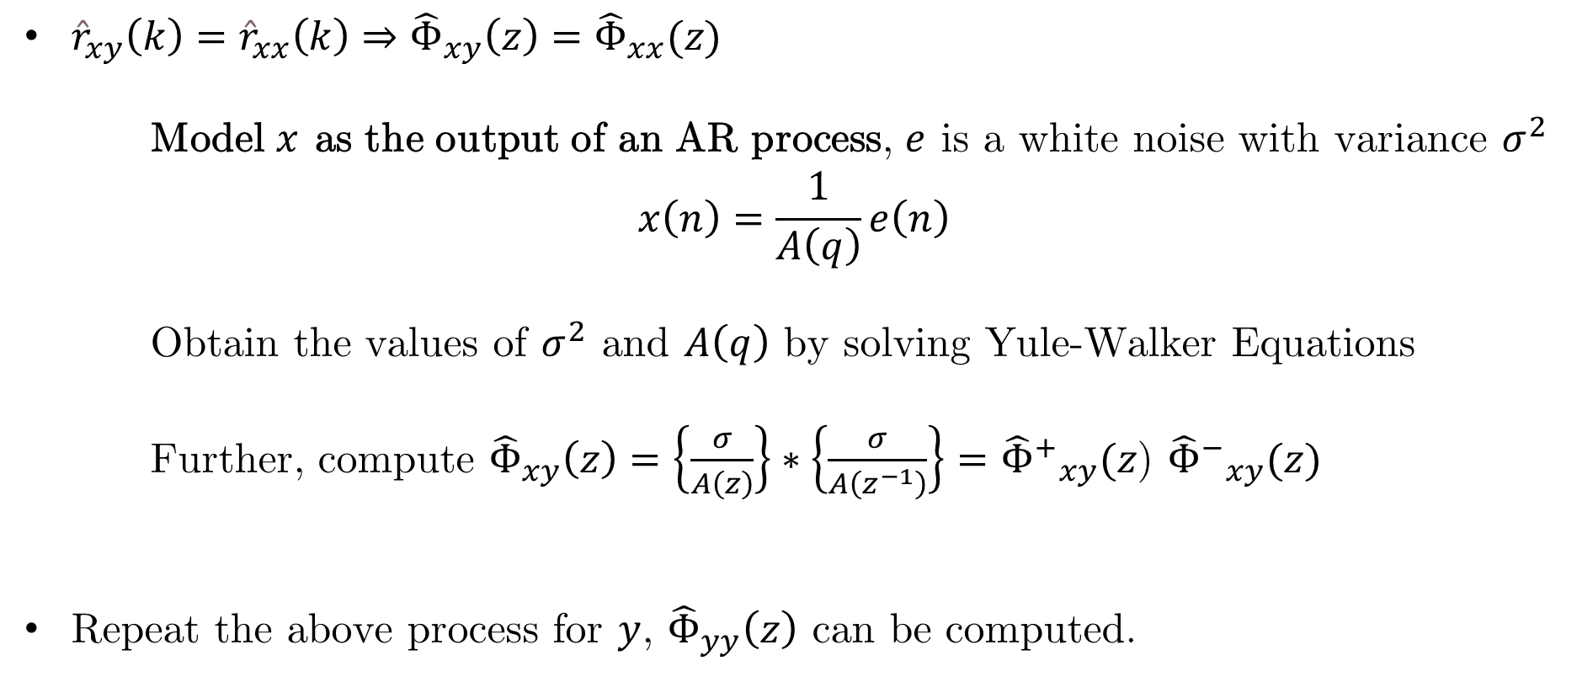
Spectrum Estimation / AR Processes
${\hat{r}}_{xy}\left(k\right)={\hat{r}}_{xx}\left(k\right)⇒{\hat{Φ}}_{xy}\left(z\right)={\hat{Φ}}_{xx}(z)$
Model $x$ as the output of an AR process, $e$ is a white noise with variance $σ^{2}$
$$x\left(n\right)=\frac{1}{A\left(q\right)}e\left(n\right)$$
Obtain the values of $σ^{2}$ and $A\left(q\right)$ by solving Yule-Walker Equations
Further, compute ${\hat{Φ}}_{xy}\left(z\right)=\left\{\frac{σ}{A\left(z\right)}\right\}∗\left\{\frac{σ}{A\left(z^{−1}\right)}\right\}={{\hat{Φ}}^{+}}_{xy}(z$) ${{\hat{Φ}}^{−}}_{xy}(z)$
Repeat the above process for $y$, ${\hat{Φ}}_{yy}\left(z\right)$ can be computed.

